Slide 1

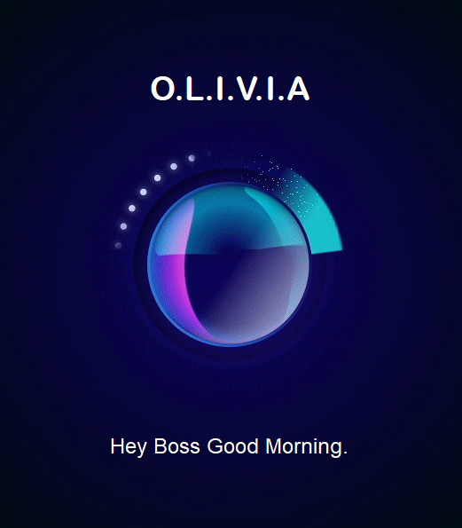

Master of Computer Applications
Major Project
On
OliVIA (Virtual Intelligent Assistant)
Prepared By-
21MCI1055 Janvi Tondon
21MCI1056 Prakashdeep Kulshrestha

Slide 2

Introduction to Project
As we all know, virtual assistants have become increasingly popular over the years, and have made our lives easier in many ways. Whether it’s getting latest news, taking screenshots, or answering our questions, virtual assistants have become an integral part of our daily lives. Our Virtual Assistant offers a sleek and hands-free interface that can perform variety of tasks with just a simple voice command. It is basically developed in python with bunch of python libraries. Let’s dive into the details and discover further possibilities of our virtual assistant.

Slide 3
Technology Used
Voice-activated virtual assistants use Natural Language Processing (NLP) to understand user requests and speech recognition technology to convert spoken words into text. They also use speech synthesis technology to respond with natural-sounding speech. These technologies have advanced significantly in recent years, enabling virtual assistants to accurately and naturally respond to user requests.

Slide 4

Existing Gaps and Project Features
Existing gaps in voice-activated virtual assistants include limited diversity and potential biases in algorithms, as well as concerns around data privacy and security. A successful project would prioritize features such as inclusive design, accessibility, and strong encryption, as well as the ability to handle complex requests and interactions.

Slide 5

Scope/Relevance
Voice-activated virtual assistants have vast and expanding scope and relevance, transforming the way we interact with technology and access services across a wide range of industries, including healthcare, education, and customer service. With advancing technology, virtual assistants are becoming more sophisticated and personalized.

Slide 6
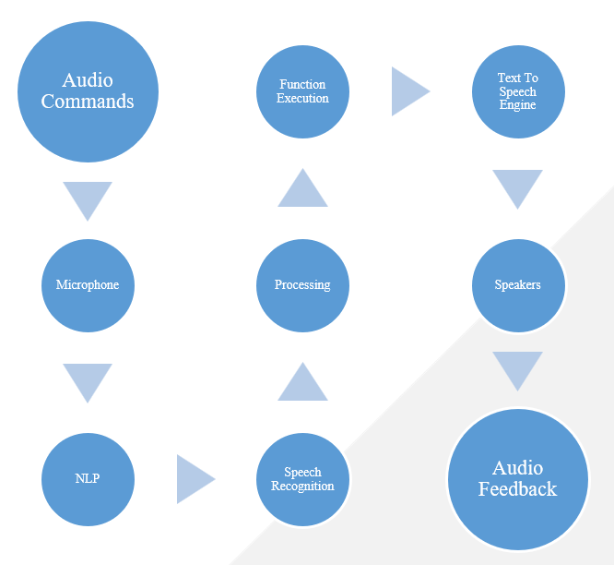
Project Design Flow
User gives a command then mic record it and forward it to NLP module that will understand the user request and then speech recognition will convert voice into text. Then it will search for the defined function for the request and perform the suitable actions and generate response. Then it will use Text to speech engine to convert the textual response into voice. In last, it will respond with an audio feedback using speakers.

Slide 7
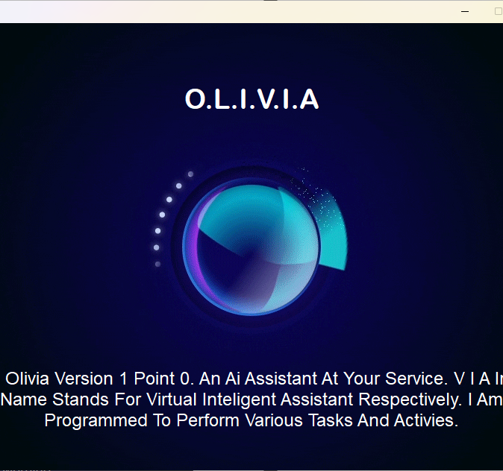
Test Cases
We performed various tests that includes, Speech recognition accuracy, Wake word detection, Response generation, Speech synthesis, Error handling, and a lot of voice commands like, weather update, current time, searching random things on internet, finding places on google maps, and many more.

Slide 8
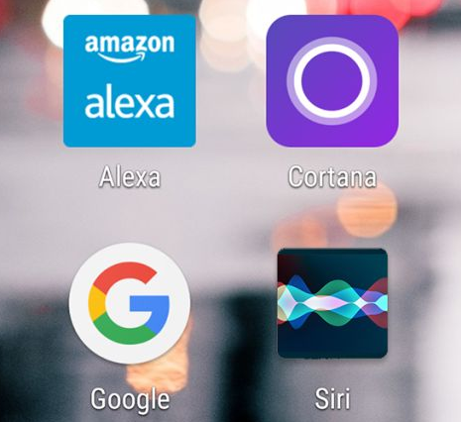
Comparative Analysis
Amazon Alexa is known for its extensive third-party skills, while Google Assistant is praised for its natural language processing. Apple Siri is integrated with Apple's ecosystem, while Microsoft Cortana is popular for business use. In terms of accuracy, Google Assistant has the highest speech recognition accuracy, while Amazon Alexa has the highest number of skills available. The choice of virtual assistant ultimately depends on individual preferences and needs, with privacy and security features also being a consideration.

Slide 9

Conclusion
Voice-activated virtual assistants have become increasingly popular due to their convenience and ease of use. However, as with any technology, it is important to carefully evaluate their capabilities and performance to ensure they meet individual needs and priorities. When choosing a virtual assistant, users may consider factors such as third-party skills, natural language processing, device integration, accuracy, and privacy and security features. By understanding the strengths and weaknesses of different virtual assistants, users can select the one that best suits their needs and preferences.

Slide 10
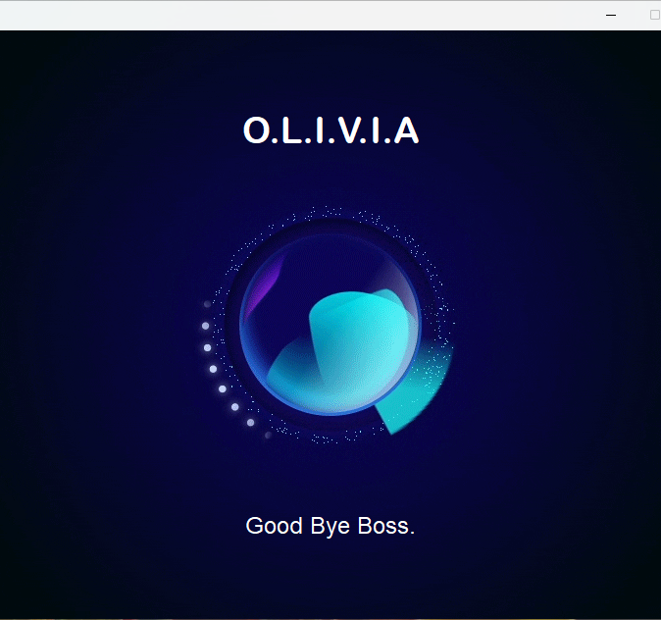
Any Questions?

